Slide 1

6th Grade Math
Unit 5, Lesson 1 Plotting Integers Using One-Unit Scales for Axes Volume 1, pg. 201

Slide 2


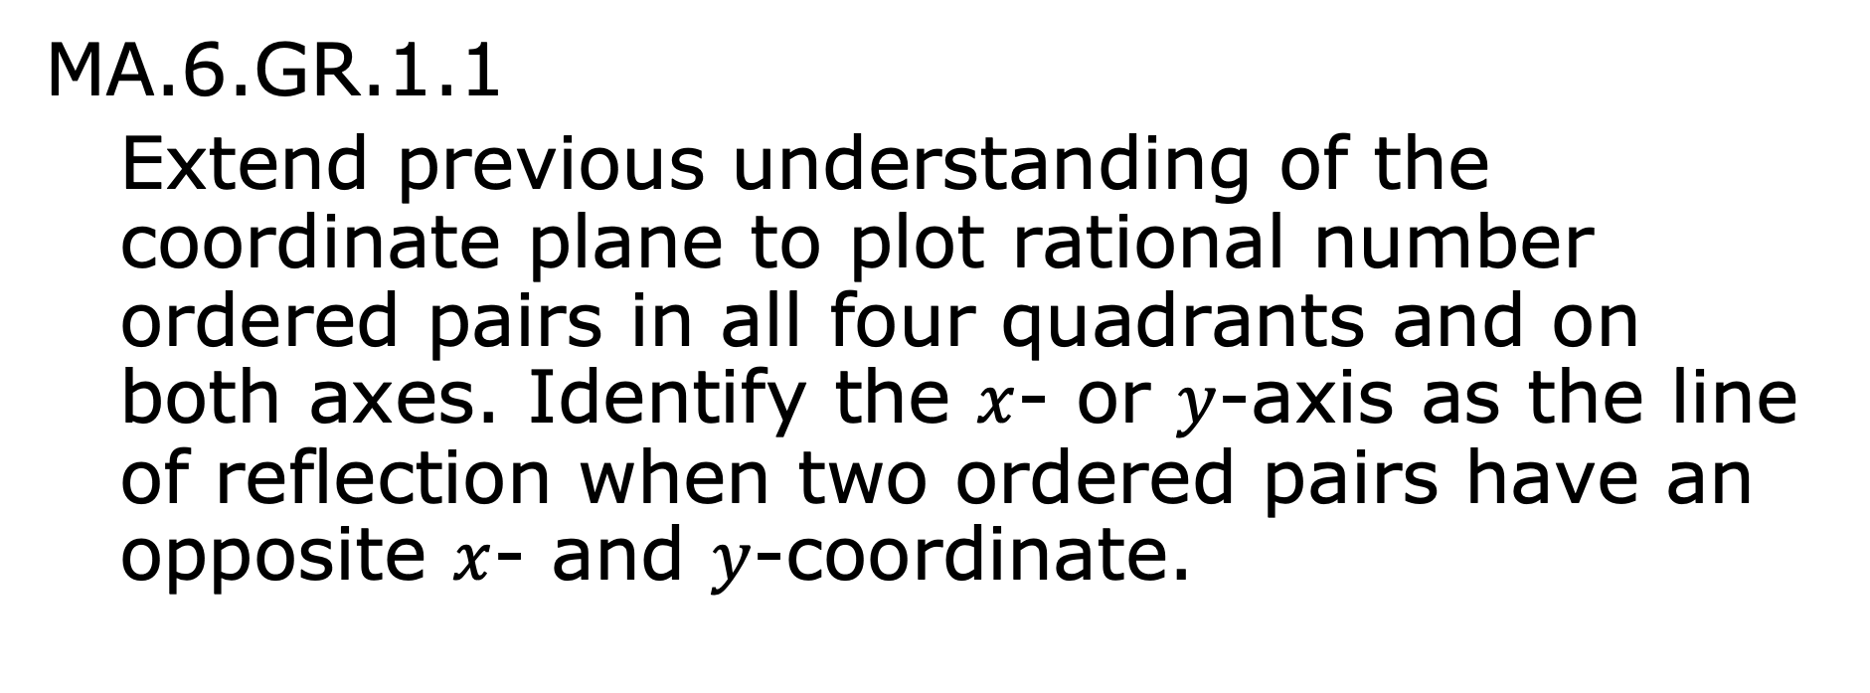
Benchmark
MA.6.GR.1.1
Extend previous understanding of the coordinate plane to plot rational number ordered pairs in all four quadrants and on both axes. Identify the $x$- or $y$-axis as the line of reflection when two ordered pairs have an opposite $x$- and $y$-coordinate.
volume 1, pg. 201

Slide 3
Integrated Mathematical Thinking and Reasoning Standards
MA.K12.MTR.1.1 Actively participate in effortful learning both individually and collectively.
MA.K12.MTR.4.1 Engage in discussions that reflect on the mathematical thinking of self and others.
MA.K12.MTR.5.1 Use patterns and structure to help understand and connect mathematical concepts.
volume 1, pg. 201

Slide 4

Learning Target
I can plot with integers using one-unit scales for axes.
volume 1, pg. 201

Slide 5

Warm-Up
volume 1, pg. 201

Slide 6


5.1.1 Warm-Up: Guess the Number
An image of $\frac{1}{4}$ cup of candy corn is shown.
Estimate the number of pieces of candy corn that are in the measuring cup.
volume 1, pg. 201

Slide 7
Ask two classmates the value they estimated. Record their value and write your summary of their reason. You are the only person who should write in the first two columns of the table. Have the person initial next to your summary stating that your summary is correct.
Guess | My Summary of Their Reason | Initials
volume 1, pg. 201

Slide 8
How close was your estimate to the actual number?
volume 1, pg. 201

Slide 9

Exploration
volume 1, pg. 202

Slide 10

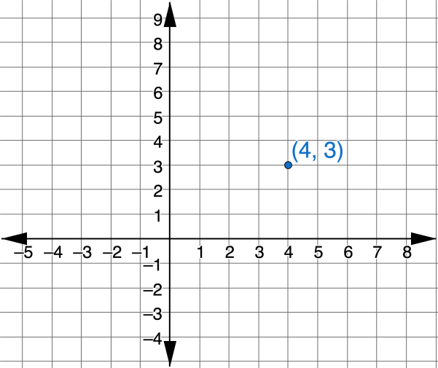

5.1.2 Exploration: The Coordinate Plane
This graph shows a point that is plotted on a coordinate plane.
The two numbers are called the coordinates. The two numbers are also known as an ordered pair,$\left(x, y\right)$.
volume 1, pg. 202

Slide 11
Discuss with your partner which coordinate will change if the point is dragged from left to right.
Discuss with your partner which coordinate will change if the point is dragged up or down.
volume 1, pg. 202

Slide 12
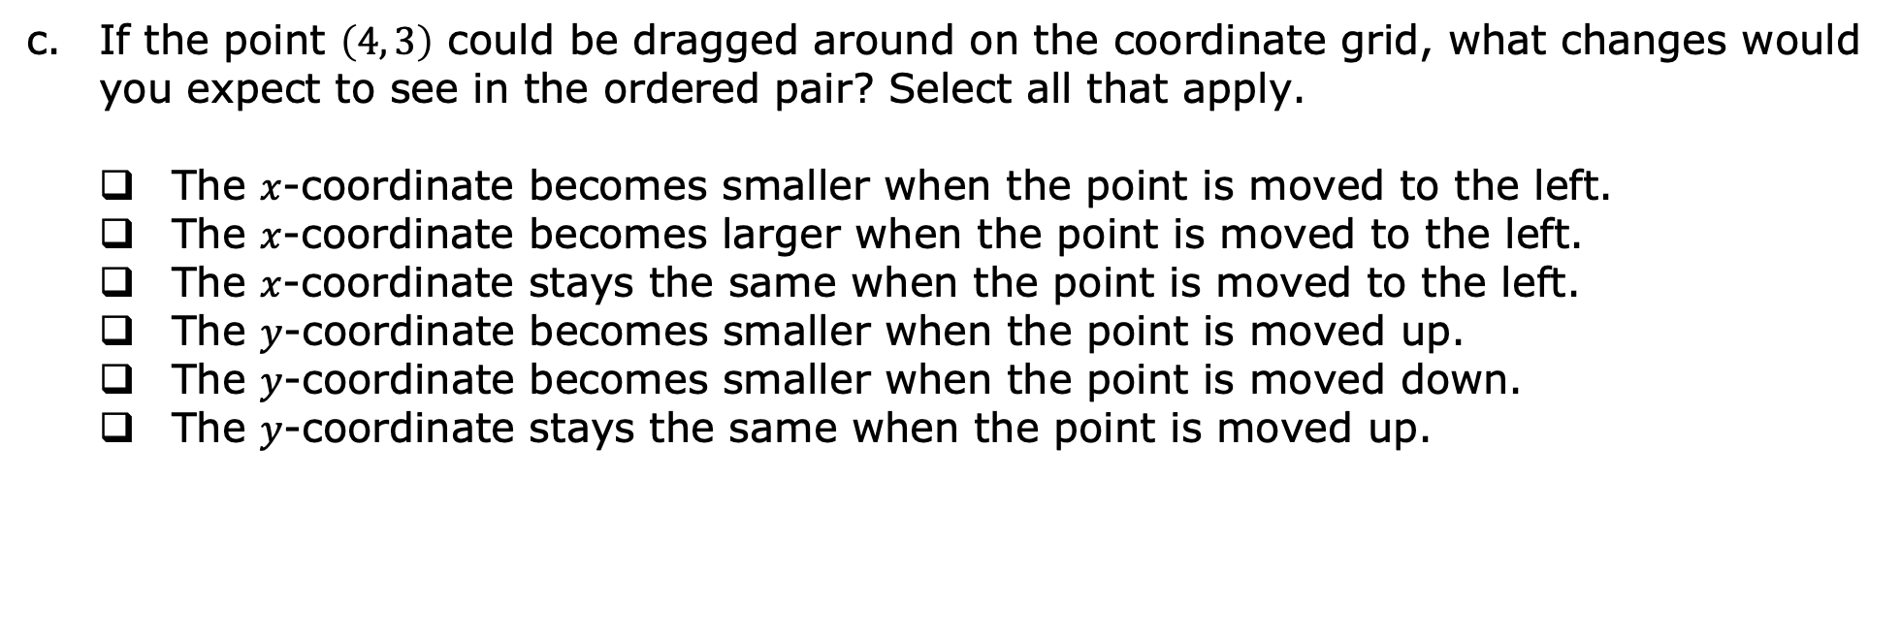
If the point $\left(4, 3\right)$ could be dragged around on the coordinate grid, what changes would you expect to see in the ordered pair? Select all that apply.
The $x$-coordinate becomes smaller when the point is moved to the left.
The $x$-coordinate becomes larger when the point is moved to the left.
The $x$-coordinate stays the same when the point is moved to the left.
The $y$-coordinate becomes smaller when the point is moved up.
The $y$-coordinate becomes smaller when the point is moved down.
The $y$-coordinate stays the same when the point is moved up.
volume 1, pg. 202

Slide 13
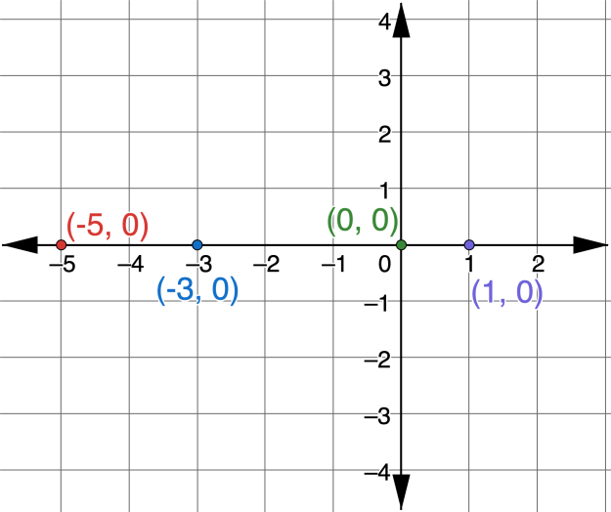
Four points are plotted on the coordinate grid.
What do you notice about all four points?
volume 1, pg. 202

Slide 14

What is the same about the points?
What is different about the points?
Discuss with your partner what is true about all the points on the $x$-axis.
volume 1, pg. 203

Slide 15
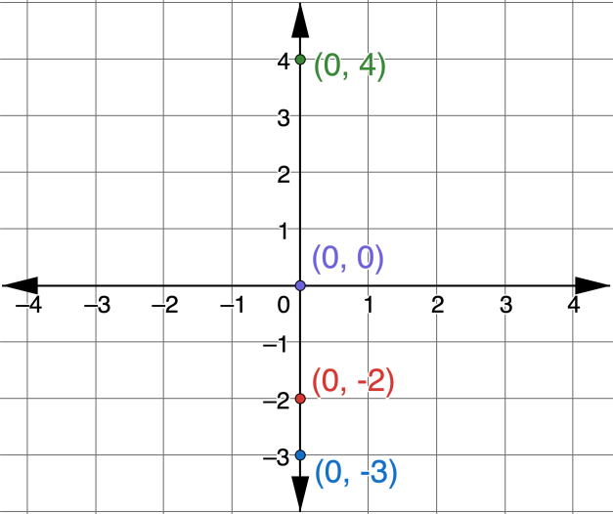
Four points are plotted on the coordinate grid.
What is the same about the points?
volume 1, pg. 203

Slide 16
What is different about the points?
volume 1, pg. 203

Slide 17
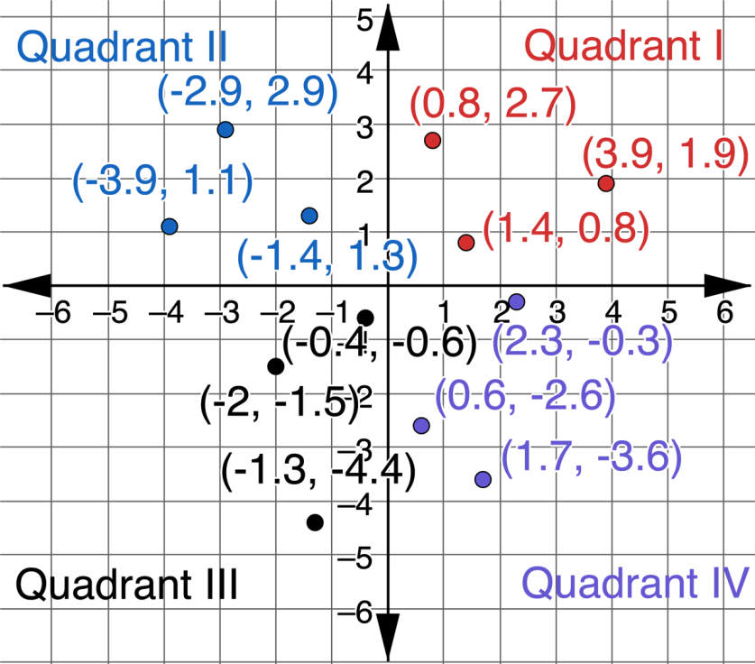
Twelve points are plotted on the coordinate grid. The grid shows the labels Quadrant I, Quadrant II, Quadrant III, and Quadrant IV.
volume 1, pg. 204

Slide 18
Work with your partner to summarize the characteristics of the points in each quadrant. Write your summary in the table.
Quadrant I
Quadrant II
Quadrant III
Quadrant IV
volume 1, pg. 204

Slide 19

Bring It Together
volume 1, pg. 204

Slide 20

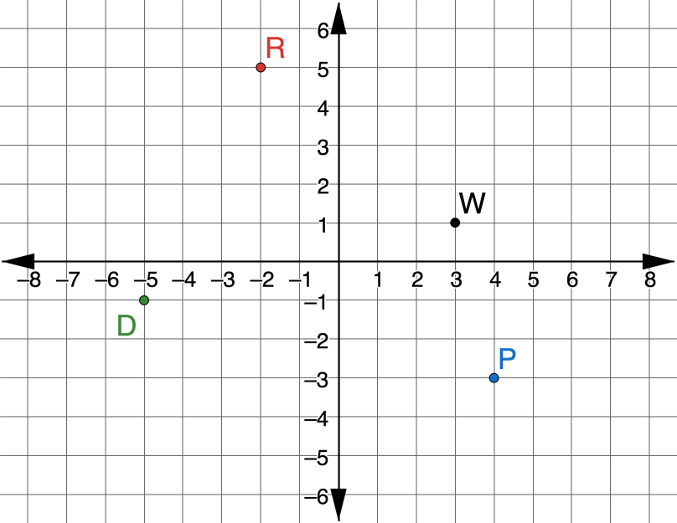
5.1.3 Bring It Together: Plotting Overhead Pairs
Points $D$, $P$, $R$, and $W$ are plotted on the coordinate grid.
volume 1, pg. 204

Slide 21
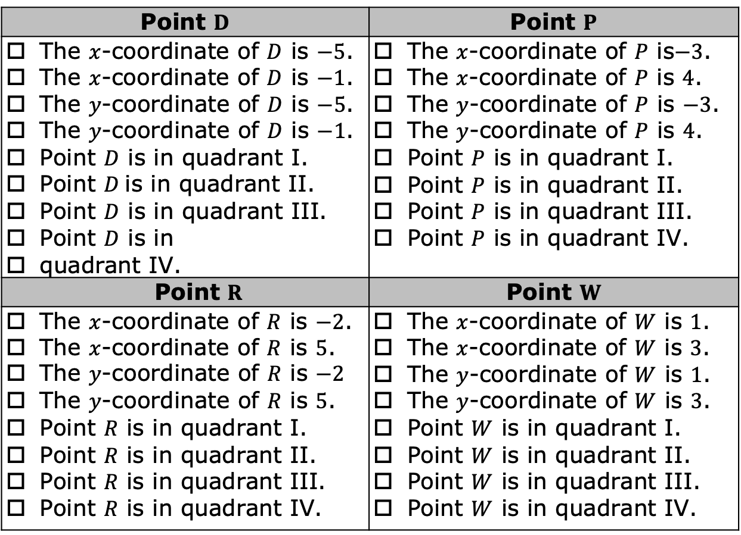
Select all of the descriptions of each point.
Point $D$ | Point $P$
The $x$-coordinate of $D$ is $−5$. The $x$-coordinate of $D$ is $−1$. The $y$-coordinate of $D$ is $−5$. The $y$-coordinate of $D$ is $−1$. Point $D$ is in quadrant I. Point $D$ is in quadrant II. Point $D$ is in quadrant III. Point $D$ is in quadrant IV. | The $x$-coordinate of $P$ is$−3$. The $x$-coordinate of $P$ is $4$. The $y$-coordinate of $P$ is $−3$. The $y$-coordinate of $P$ is $4$. Point $P$ is in quadrant I. Point $P$ is in quadrant II. Point $P$ is in quadrant III. Point $P$ is in quadrant IV.
Point $R$ | Point $W$
The $x$-coordinate of $R$ is $−2$. The $x$-coordinate of $R$ is $5$. The $y$-coordinate of $R$ is $−2$ The $y$-coordinate of $R$ is $5$. Point $R$ is in quadrant I. Point $R$ is in quadrant II. Point $R$ is in quadrant III. Point $R$ is in quadrant IV. | The $x$-coordinate of $W$ is $1$. The $x$-coordinate of $W$ is $3$. The $y$-coordinate of $W$ is $1$. The $y$-coordinate of $W$ is $3$. Point $W$ is in quadrant I. Point $W$ is in quadrant II. Point $W$ is in quadrant III. Point $W$ is in quadrant IV.
volume 1, pg. 204

Slide 22
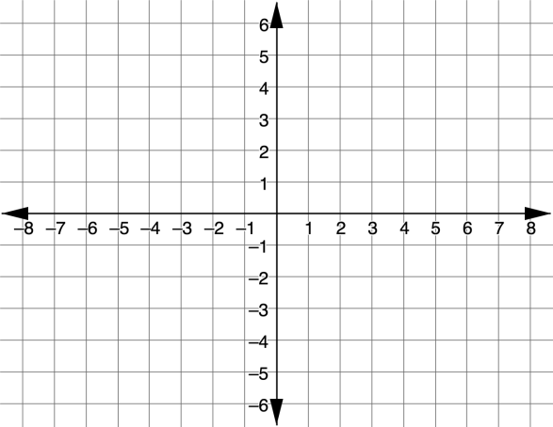
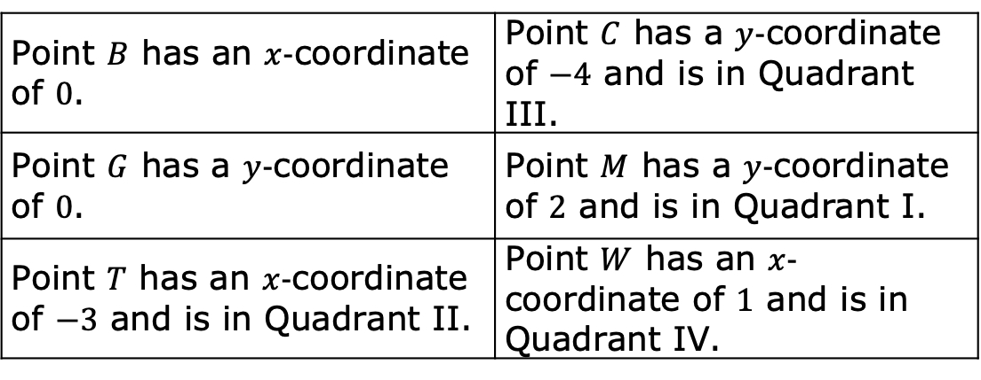
Use the coordinate grid to plot and label points that have the characteristics described in the table.
Point $B$ has an $x$-coordinate of $0$. | Point $C$ has a $y$-coordinate of $−4$ and is in Quadrant III.
Point $G$ has a $y$-coordinate of $0$. | Point $M$ has a $y$-coordinate of $2$ and is in Quadrant I.
Point $T$ has an $x$-coordinate of $−3$ and is in Quadrant II. | Point $W$ has an $x$-coordinate of $1$ and is in Quadrant IV.
volume 1, pg. 205

Slide 23

Guided Instruction
volume 1, pg. 205

Slide 24

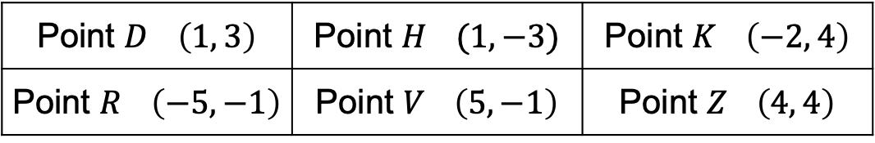
5.1.4 Guided Instruction: Reflections
Use the points in the table for the following.
Plot the ordered pairs from the table on the coordinate grid below. Label using the given letter.
Point $D$ $\left(1, 3\right)$ | Point $H$ $(1, −3)$ | Point $K$ $\left(−2, 4\right)$
Point $R$ $\left(−5,−1\right)$ | Point $V$ $\left(5, −1\right)$ | Point $Z$ $\left(4, 4\right)$
volume 1, pg. 205

Slide 25

Select the pair of points that have the same $x$-coordinate.
Select the pair of points that have a $y$-coordinate of $−1$.
$D$ | $H$ | $K$ | $R$ | $V$ | $Z$
$D$ | $H$ | $K$ | $R$ | $V$ | $Z$
volume 1, pg. 205

Slide 26
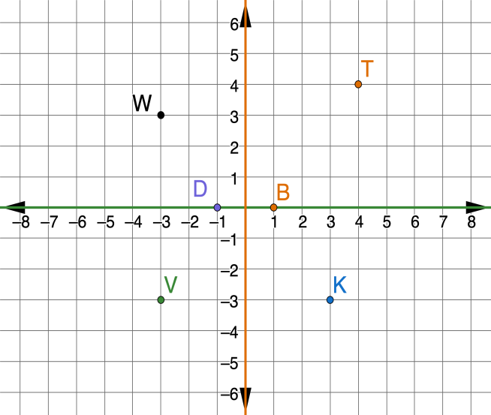

A coordinate grid with points $D$, $B$, $K$, $T$, $V$, and $W$ is shown. The $x$-axis is green and the $y$-axis is orange.
Write the ordered pair of the reflection of Point V when the graph is folded across the $x$-axis.
volume 1, pg. 206

Slide 27
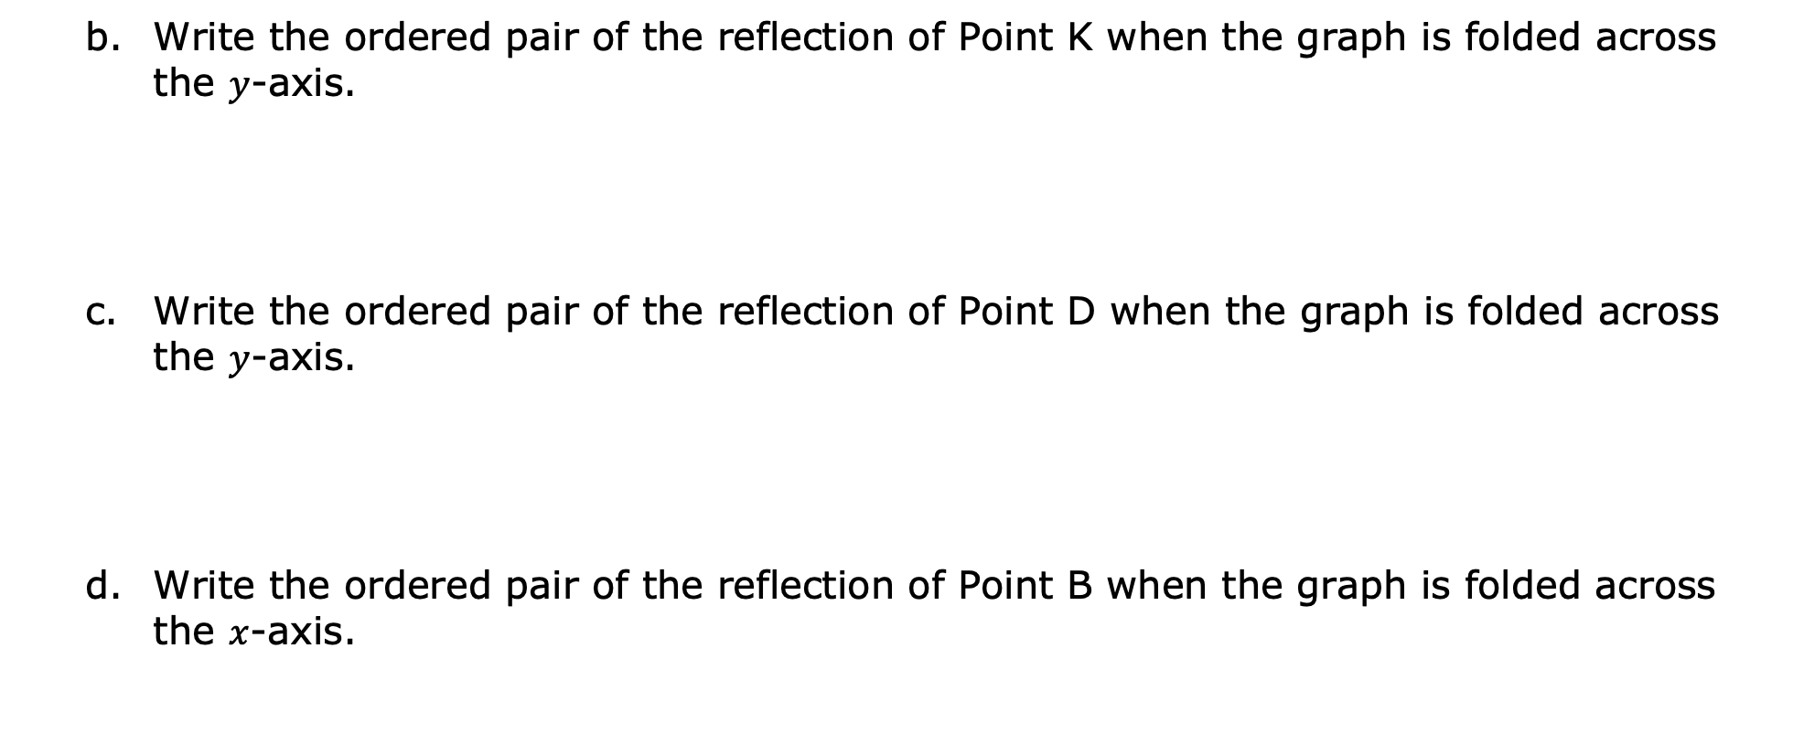
Write the ordered pair of the reflection of Point K when the graph is folded across the $y$-axis.
Write the ordered pair of the reflection of Point D when the graph is folded across the $y$-axis.
Write the ordered pair of the reflection of Point B when the graph is folded across the $x$-axis.
volume 1, pg. 206

Slide 28

Guided Practice
volume 1, pg. 206

Slide 29

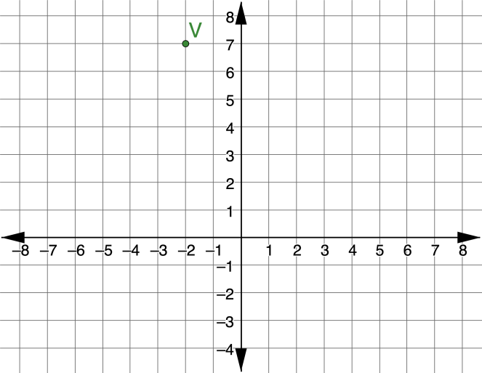

5.1.5 Guided Practice: Reflections
Point $V$ is plotted on the coordinate grid.
What are the coordinates of the reflection of $V$ across the $y$-axis?
volume 1, pg. 206

Slide 30
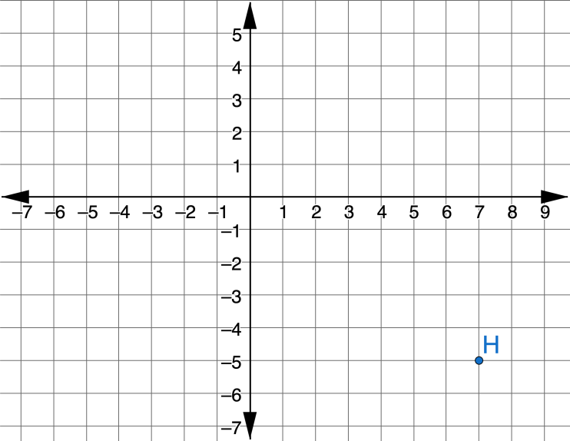

Point $H$ is plotted on the coordinate grid.
What are the coordinates of the reflection of $H$ across the $x$-axis?
volume 1, pg. 207

Slide 31

Wrap-Up
volume 1, pg. 207

Slide 32
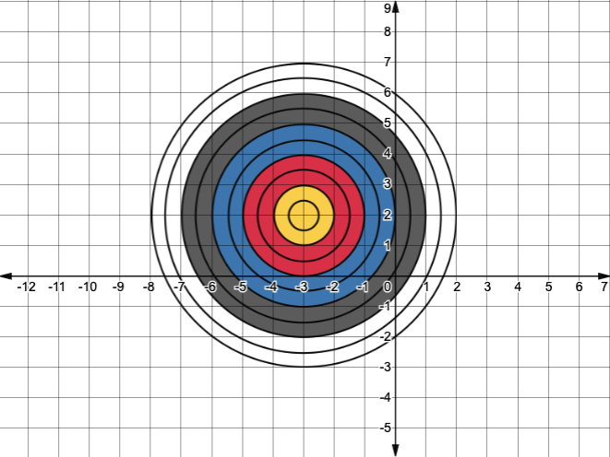
5.1.6 Wrap-Up: Ticket Out the Door
A target is shown on the coordinate grid.
Write the ordered pair that will hit the bullseye.
volume 1, pg. 207

Slide 33
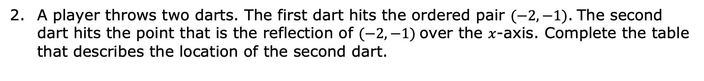
A player throws two darts. The first dart hits the ordered pair $(−2,−1)$. The second dart hits the point that is the reflection of $(−2,−1)$ over the $x$-axis. Complete the table that describes the location of the second dart.
Color | Ordered Pair
volume 1, pg. 207

